Slide 1


MICROPROCESSOR AND COMPUTER ARCHITECHTURE
Basic Performance
issues in pipeline
Credits:
MPCA Team
Notes:
<number>

Slide 2
Performance Issues - Pipelining
Pipelining increases CPU throughput.
Does not reduce the execution time of an individual instruction, in fact, it slightly increases due to overhead in the control of the pipeline.
Program total execution time is decreased. i.e., The program executes faster, even though no single instruction runs faster!
Execution time of each instruction does not decrease, puts limit on the practical depth of the pipeline.
Notes:
<number>

Slide 3
Performance Issues - Pipelining
Pipeline Latency: Limits arise from the imbalance among the pipeline stages and pipelining overhead.
Pipeline Imbalance: reduces performance as clock can run no faster than the time needed for the slowest pipeline stage arises from the imbalance. Pipelining increases CPU throughput.
Notes:
<number>

Slide 4
Performance Issues - Pipelining
Pipeline overhead: combination of pipeline register delay and the clock skew.
Pipeline registers delay: add setup time that triggers a write and propagation delay to the clock.
Clock skew: Maximum delay between when the clock arrives at any two registers.
Notes:
<number>

Slide 5
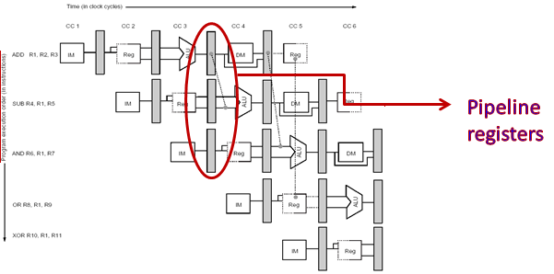
Performance Issues - Pipelining
Notes:
<number>

Slide 6
Performance Issues - Pipelining
Simple RISC pipeline would function fine for integer instructions if every instruction were independent of every other instruction in the pipeline – Ideal Pipeline
But, in reality instructions in the pipeline can depend on one another- Dependency
This prevents the next instruction to execute during its designated clock cycle.
This situations are called Hazards.

Slide 7
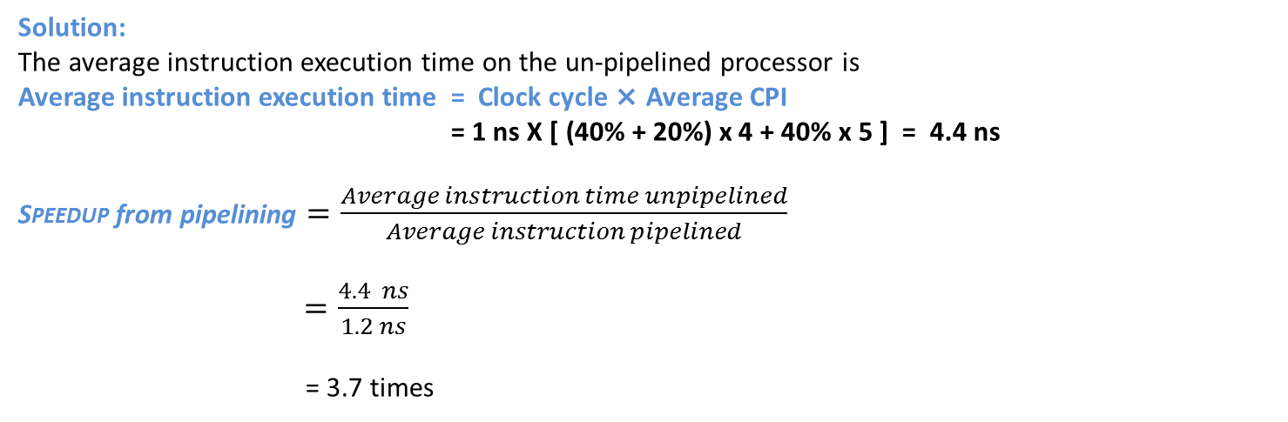
Speedup from pipelining - Example
Consider the un-pipelined processor in the previous section. Assume that it has a 1ns clock cycle and that it uses 4 cycles for ALU operations and branches and 5 cycles for memory operations. Assume that the relative frequencies of these operations are 40%, 20%, and 40%, respectively. Suppose that due to clock skew and setup, pipelining the processor adds 0.2 ns of overhead to the clock. Ignoring any latency impact, how much speedup in the instruction execution rate will we gain from a pipeline?

Slide 8
Pipelining hazards

Slide 9
Pipeline Hazards
Pipeline Hazards are situations that prevent the next instruction in the instruction stream from executing in its designated clock cycle.
Hazards reduce the performance from the ideal speedup gained by pipelining. Thus, the CPI is greater than the ideal value of 1.
Three types of hazards
Structural hazards
Arise from resource conflicts when the hardware can’t support all possible combinations of overlapping instructions
Data hazards
Arise when an instruction depends on the results of a previous instruction in a way that is exposed by overlapping of instruction in pipeline
Control hazards
Arise from the pipelining of branches and other instructions that change the PC (Program Counter)

Slide 10
Pipeline Hazards
Hazards in pipeline can make the pipeline to stall.
Eliminating a hazard often requires that some instructions in the pipeline to be allowed to proceed while others are delayed.
When an instruction is stalled, instructions issued latter than the stalled instruction are stopped, while the ones issued earlier must continue.
Otherwise, hazard will never clear.
No new instructions are fetched during the stall.
It is not complex as it might sound!

Slide 11
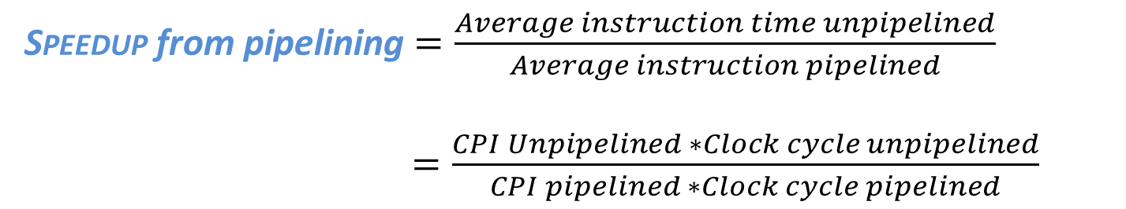
Pipeline Hazards
A stall causes the pipeline performance to degrade from ideal performance.
To compute the actual speedup from pipelining……..

Slide 12
Speedup from pipelining with Stalls
Pipelining decreases the CPI or clock cycle time.
Traditional to use CPI to compare pipelines.
Assuming that the ideal CPI on a pipelined processor is almost always 1.
Computation of pipelined CPI is given by,
CPI pipelined = Ideal CPI+Pipeline stall clock cycles per instruction
=1+Pipeline stall clock cycles per instruction
$Speedup=\frac{\text{CPI} \text{unpipelined}\text{ ∗ }\text{Clock} \text{cycle} \text{unpipelined}}{\text{CPI} \text{pipelined}\text{ ∗ }\text{Clock} \text{cycle} \text{pipelined}}$

Slide 13
Speedup from pipelining with Stalls
Ignoring, the cycle time overhead of the pipelining and assuming that the pipeline stages are perfectly balanced, then the cycle time of the two processors can be equal. Then,

Slide 14
Speedup from pipelining with Stalls - continued
Case 1 :
All instructions take the same number of cycles, which equals the number of pipeline stages – also called depth of the pipeline.
In the earlier case, Un-pipelined CPI = The depth of the pipeline or pipeline depth.
i.e.,
And if there are no pipeline stalls, Then, pipelining can improve the performance by the depth of the pipeline.

Slide 15
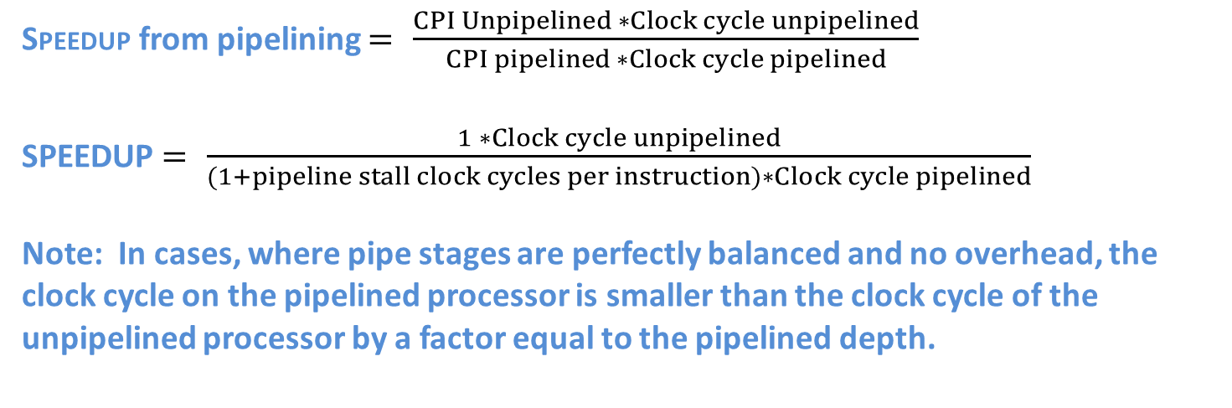
Speedup from pipelining with Stalls - continued
Case 2: If pipelining has improving the clock cycle time, then, it can be assumed that. Then, Un-pipelined CPI = Pipelined = 1

Slide 16
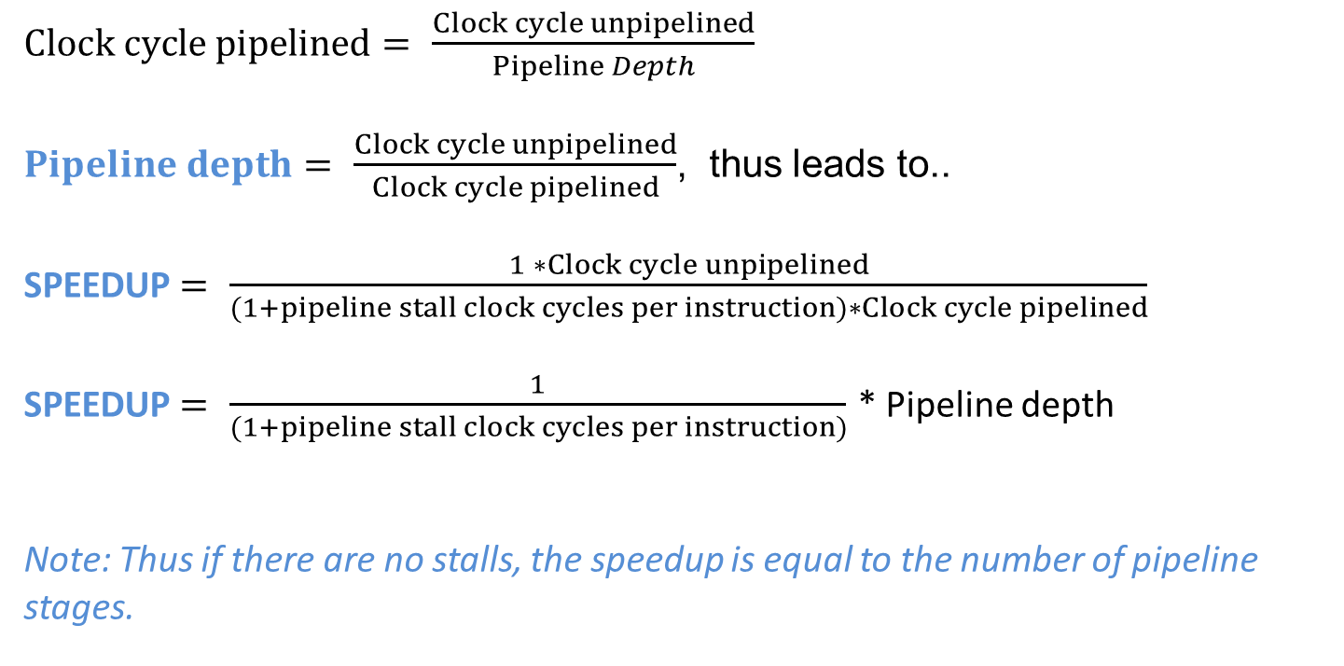
Speedup from pipelining with Stalls - continued

Slide 17
Structural Hazards
If certain combination of instructions can’t be accommodated because of resource conflicts, the machine is said to have a structural hazard.
It can be generated by:
Some functional unit is not fully pipelined.
Some resources has not been duplicated enough to allow all the combinations in the pipeline to execute.

Slide 18
Ways To Overcome Structural Hazards
Duplicate resources
Pipeline the resources
Reordering instructions
Pipeline stalling
No new instruction will be executed until the hazard has been solved

Slide 19
Structural Hazards
Ex: A machine may have only one register file write port, but under certain conditions, the pipeline might want to perform two writes in one clock cycle – this will generate structural hazard.
When a sequence of instructions encounter this hazard, the pipeline will stall one of the instructions until the required unit is available.
Such stalls will increase the Clock cycle Per Instruction from its ideal 1 for pipelined machines.

Slide 20
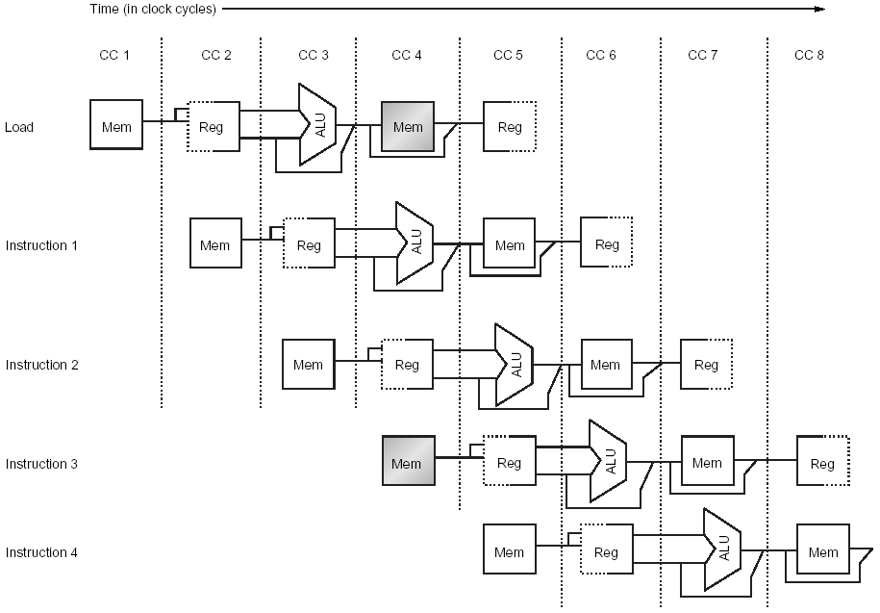
Structural Hazards
Consider a Von Neumann architecture (same memory for instructions and data)
Notes:
<number>
As a result, when an instruction will perform a data reference, will conflict with an instruction fetch.
In this example, the load instruction wants to access the memory to load data at the same time when instruction 3 wants to fetch an instruction from memory.

Slide 21
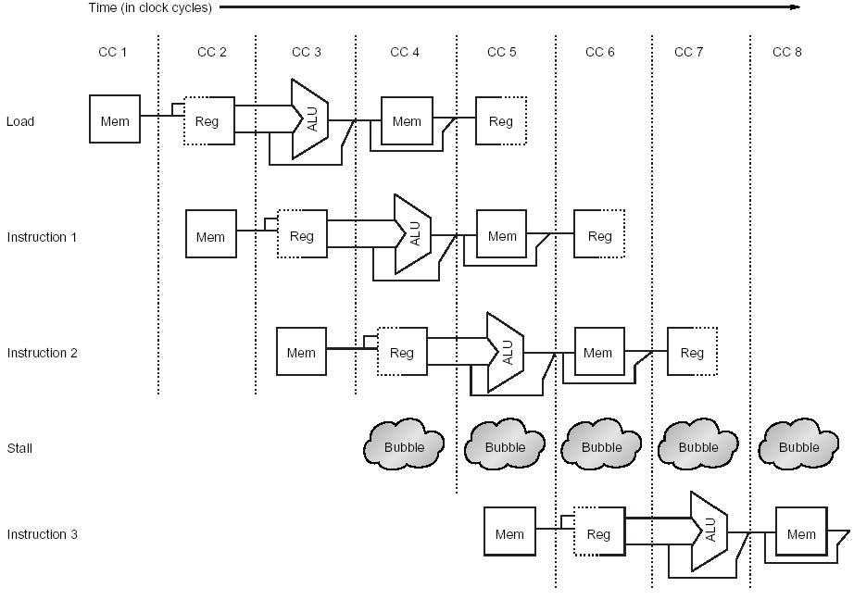
Structural Hazards
Stall cycle added (commonly called pipeline bubble)
Notes:
<number>
To solve the problem, a stall cycle is added. The effect of the pipeline bubble is actually to occupy the resources for that instruction slot as it travels through the pipeline. Performance wise, instruction 3 will not complete during clock cycle 8, but during clock cycle 9.

Slide 22
Structural Hazards
Instruction Number | Clock number
 | 1 | 2 | 3 | 4 | 5 | 6 | 7 | 8 | 9 | 10
load | IF | ID | EX | MEM | WB
Instruction i+1 |  | IF | ID | EX | MEM | WB
Instruction i+2 |  |  | IF | ID | EX | MEM | WB
Instruction i+3 |  |  |  | stall | IF | ID | EX | MEM | WB
Instruction i+4 |  |  |  |  |  | IF | ID | EX | MEM | WB
Instruction i+5 |  |  |  |  |  |  | IF | ID | EX | MEM
Another way to represent the stall – no instruction is initiated in clock cycle 4
Notes:
<number>
Sometime those diagrams are drawn with a stall occupying a whole raw, with instruction 3 being moved to the next raw. In either case, the effect is the same. The instruction 3 is not beginning execution until cycle 5.

Slide 23
Structural Hazards
A machine without structural hazard will have lower CPI
Why a designer allows structural hazard?
To reduce cost
Pipelining all the functional units or duplicating them may be too costly
To reduce latency
Introducing too many pipeline stages may cause latency issues

Slide 24
Q & A
Pipeline Hazards : Structural Hazards
Notes:
12/02/20
<number>

